Slide 1

WeChat Mini Game
The eighteenth group
Speaker:Liang Hong,Wu Jiaxian,
Li Houcai,Lai Zhiyu,Huang Junyu

Slide 2
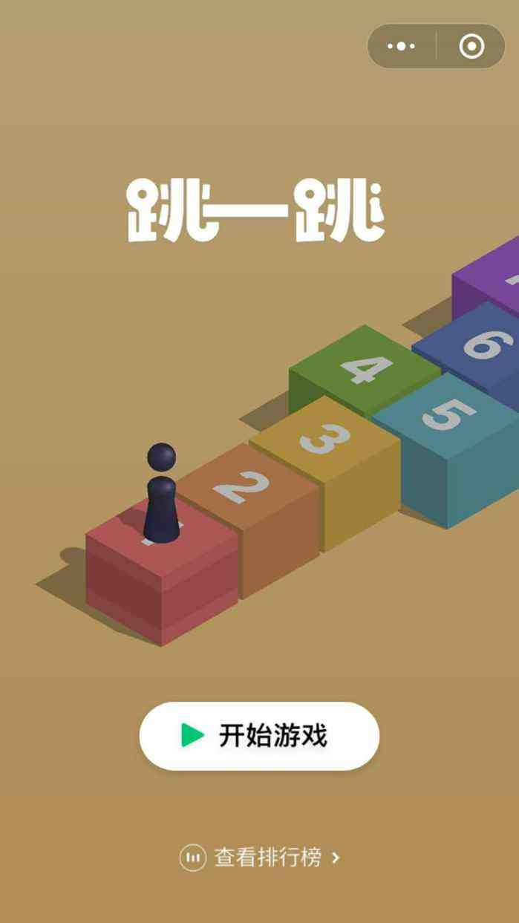
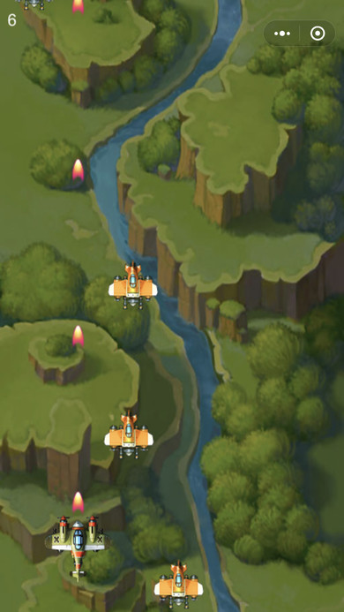
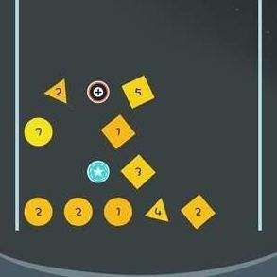
What is WeChat Mini Game
Jump a jump
Thunder and lightning
Tan Yi Tan
Wechat Mini Games is a category of Wechat Mini Programs.Different from traditional games,it,You can play as soon as you click, you don’t need to download,install,manage or even uninstall.it is very light and convenient.Users can play with their good friends,such as PK,watch,etc.
The types of WeChat Mini Games are very rich,such as leisure,action,chess,role-playing,competitive,etc.
At present,users can search for mini games through Wechat’s Search,for instance jump a jump to experience.You can also check out the mini-games that you have played through drop down Wechat homepage.

Slide 3
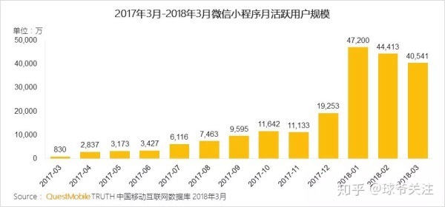

Slide 4
Why WeChat games will be hot?
These games are easy to operate. You can get high marks without having to learn complicated operation, so that people of different ages can play.
Play in a simple way
Human beings can be divided into two groups: busy people and leisurely people. Busy people occasionally need to relax themselves and make full use of fragmentation time. And leisurely people need to kill time. The WeChat game just satisfied the needs of these people.
Kill time
When the game is over, if you share the game to WeChat group or circle of friends, you can continue the game. This makes the game spread like a virus
Special rules of the game

Slide 5
People who plays the mini programs can be divided into 4 groups by age
This age group indulges in the Wechat small programs to play games.
Because most of them don't have their own phone, and their parents' mobile phones usually don't have mach games.So,the small programs became the best choise due to it's no need to download.
This age group uses the small programs because it's convenience.They can order meal and kill time when they on the way to work or lunch.
请替换文字内容
children(3-10)
young(11-25)
worker(26-50)
the old（50and older)
This age group mainly for competing with each other.Each wechat games has it's own leaderboard,which will inspires people's desire to win them who rank higher than him.
This age group don't spend a lot of time to use small program.They just think it as an entertainment project.

Slide 6
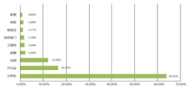
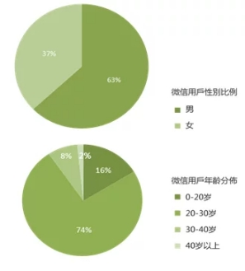
The advantages of WeChat
Compared to other platforms, WeChat has its own unique advantages.
First of all, WeChat has an advantage in the number of users.At present, WeChat has more than one billion active users, 70 percent of whom are at the age of 20 to 30, and 90 percent have a high level of being educated.
Secondly, people can use a variety of languages by programming WeChat app, such as C#, CSS, HTML5, and so on.Because of language convenience, people can program the WeChat app just like program a web .
The most important thing is that WeChat provides servers and APIs that free you from much trouble. When you want to implement new features, you only need to find your own API in the API repository.

Slide 7
The future development trend of WeChat Mini Program
The WeChat Mini Program has a great potential.
Convenience
Low development cost
Simple operation
Large number of users
Compared to other approach，WeChat Mini Program do not have to be downloaded.
The cycle of development is very short .And it's not complicated to develop. So Its development cost is low.
The operation is very simple. It does not need to re register the account, nor does it need to bind any bank card.
WeChat itself is a huge platform for users. Therefore, WeChat provides a good user base WeChat Mini Program .

Slide 8
Thank You
The eighteenth group
Speaker:Liang Hong,Wu Jiaxian,
Li Houcai,Lai Zhiyu,Huang Junyu

